Slide 1
CSE 6040/x Programming Skills Office Hours
Week 0, Session 1
Spring 2023
January 10, 2023

Slide 2
Purpose of this OH Series
Introduce and demonstrate techniques, approaches, and methodologies that the teaching staff believes might be helpful for the students, both in the class and in their future professional roles.
Some of the steps are specific to this class and its tools, but they can be generalized to other scenarios and toolsets.
We ARE NOT here to help with specific notebook problems. Piazza and the Thursday Office Hours sessions are for that.
These sessions are intended for students who don’t have a programming background, to help with tools and techniques “beyond the language syntax”.

Slide 3
Skills OH Series Conduct
We will be conducting three “types” of sessions through the course:
Theory, code syntax, and basic programming
Code application and putting the syntax together for a solution
TA walkthroughs of various notebooks
Particularly the exam practice problem NB’s
1 or 2 Sessions each week, on Monday’s (or sometimes Tuesday’s) and Wednesday’s

Slide 4
General Topics for the Semester
Class-specific tools, Jupyter, and best practices for Vocareum
Theory, code syntax, and basic programming
Focus on areas that students have historically had issues
For example: nested data, loops, and comprehensions
Programming thought process
Troubleshooting code errors/Error messages and data
Putting the above together to solve a problem/exercise/notebook
Exam format and troubleshooting

Slide 5
Skills OH on Piazza and Zoom/Media Gallery
Prior to each Skills OH session:
Agendas for each Skills OH session will be posted at least the day prior in the pinned Piazza post.
All access to the Skills OH sessions will be via the Zoom links in the Zoom section of Canvas.
After each Skills OH session:
Recordings of every Skills OH session will be posted in the Media Gallery section of Canvas NLT 24 hours after each session’s completion.
All content, or links to the content, will be posted in the Skills OH pinned Piazza thread NLT 24 hours after each session’s completion.
Any required announcements will be posted in the Skills OH pinned Piazza post.

Slide 6
Agenda for This Week
Session 1
Intro to Programming, and a sample program
Intro to Vocareum
Session 2
Intro to Google Colab
Intro to (a suggested) Programming Process
We will cover at a high level today, and use/illustrate the process throughout the semester
Code organization, comments, and readability
How to read coding error messages (your code doesn’t run successfully)
We will cover data errors next week (code runs, but outputs incorrect data)

Slide 7
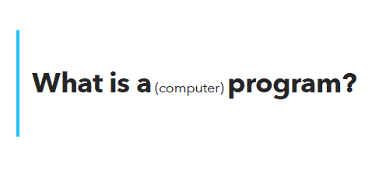
So, let’s get started
Fun YouTube video, about how to make a peanut butter and jelly sandwich.
What is the takeaway?
https://www.youtube.com/watch?v=FN2RM-CHkuI

Slide 8
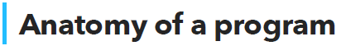
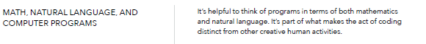
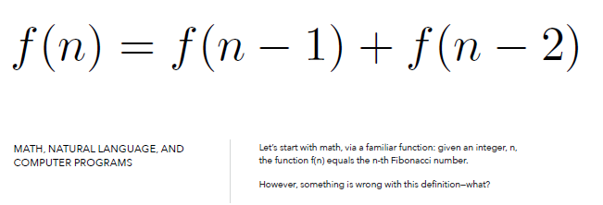
Let’s look at the definition of the Fibonacci sequence:
https://byjus.com/maths/fibonacci-sequence/

Slide 9
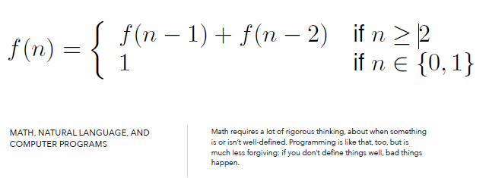

Slide 10
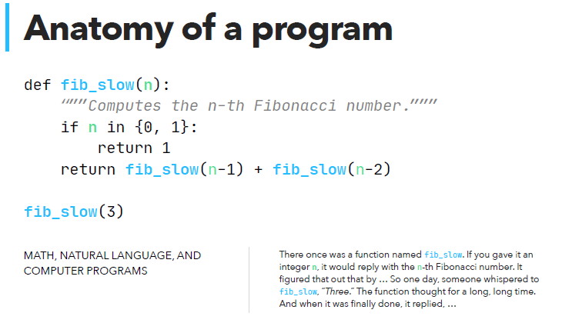

Slide 11
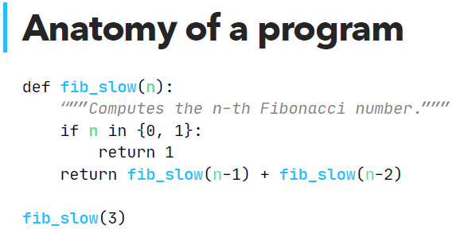
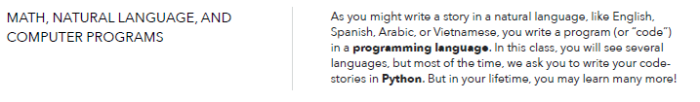

Slide 12
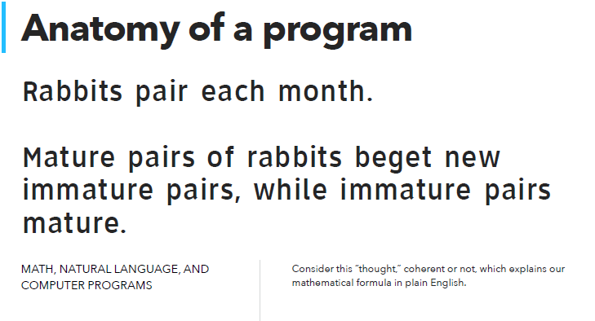

Slide 13
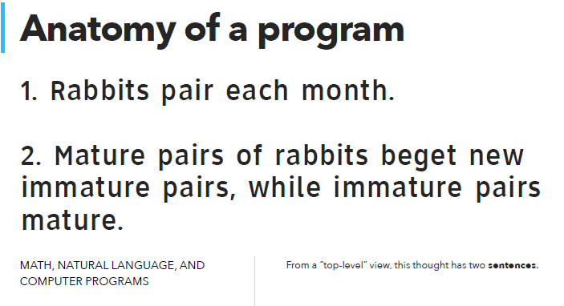

Slide 14
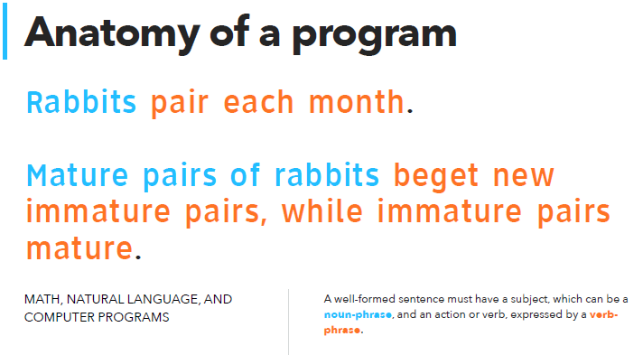

Slide 15
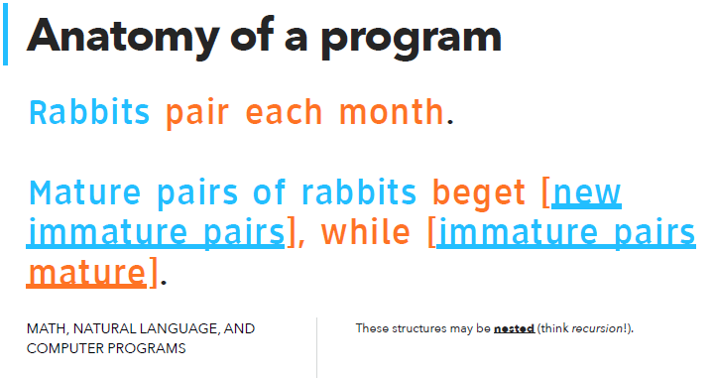

Slide 16
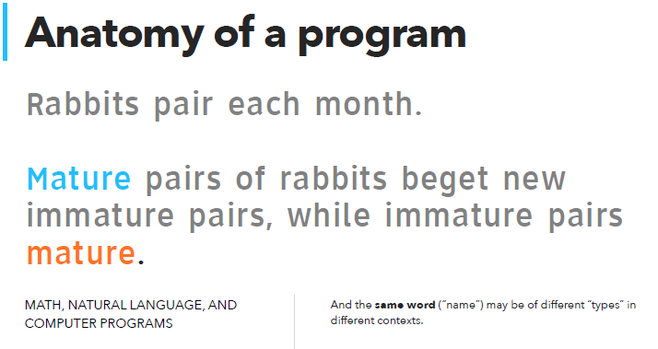

Slide 17
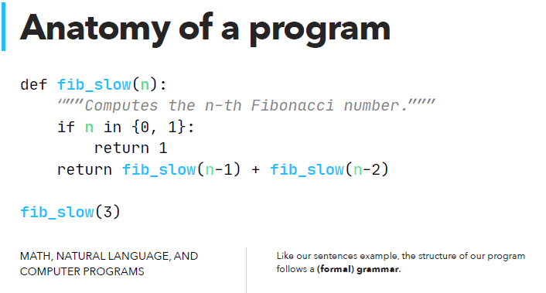

Slide 18
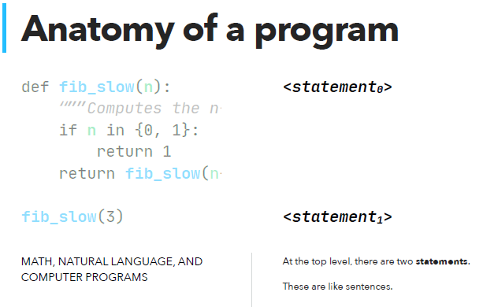

Slide 19
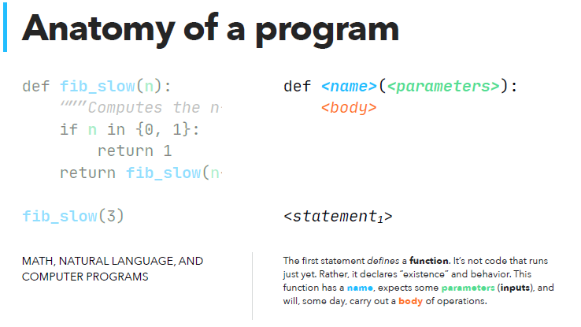

Slide 20
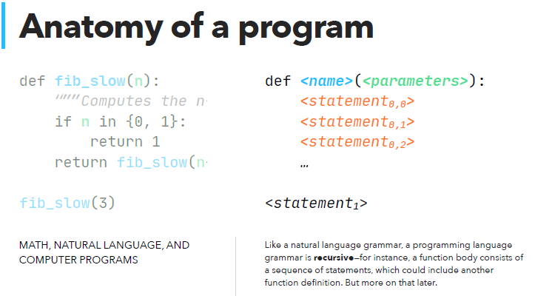

Slide 21
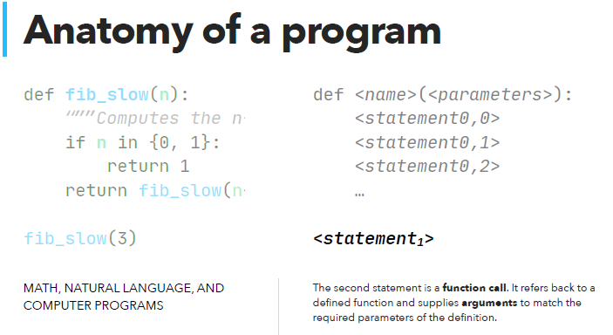

Slide 22
So, what does this look like in action?
Let’s go to the site Python Tutor, which allows you to input code and see the step-by-step execution.
Python Tutor

Slide 23
Fibonacci Two Ways Notebook -- 1
Let’s look at this notebook.
The NB computes the Fibonacci number two ways:
Using recursion (as in the example slides)
Using a For Loop (one pass through the code)

Slide 24
Fibonacci Two Ways Notebook -- 2
Why are we showing both ways?
In this class, the solutions will (most of the time) use the most efficient/succinct Python code to solve the exercises.
Comprehensions, lambda functions, and single/compound lines of code, for example.
Later in the class, you will have NB’s that require you to meet a time limit, writing the most efficient code.

Slide 25
Fibonacci Two Ways Notebook -- 3
In the Skills OH series, we recognize that many of you do not have an extensive programming background.
As a result, for many of the examples that we walk through, we will write explicit loops and steps.
We want you to see and understand the explicit steps that the loops use.
And later understand how those loops are implicitly executed in the comprehensions and other efficient Python syntaxes.

Slide 26
Intro to Vocareum --1 https://cse6040.gatech.edu/fa22/vocareum_guide.html
What is Vocareum?
Online platform for homework, tests, and any other class deliverables.
All deliverables for the course will be done in Vocareum.
Access Vocareum via Assignment link in Canvas (single signon with GT ID)
Also access via labs.Vocareum.com (will need to create ID/pwd). Only use as a last resort, but sometimes is necessary.

Slide 27
Intro to Vocareum --2 https://cse6040.gatech.edu/fa22/vocareum_guide.html
What is Jupyter, aka Jupyter Notebooks.
Development environment for Python (and other languages).
Code runs in cells, which can be run individually or in sequence.
Many good tutorials online, here are a couple:
https://www.dataquest.io/blog/jupyter-notebook-tutorial/
https://www.youtube.com/watch?v=HW29067qVWk

Slide 28
Intro to Vocareum --3 https://cse6040.gatech.edu/fa22/vocareum_guide.html
Install vs Import packages
Import is a Python command to bring a Python package into your notebook environment, provided that that package is already is installed in Vocareum.
In Vocareum, you will be able to import every package that you require for the course.
Do not attempt to install packages that are not already on Vocareum. Your notebook will not run.

Slide 29
Intro to Vocareum -- 4
The kernel – What does the status tell me.
Python version and connected (or not).
Running cells in Jupyter, and what does the indicator show.
Run individual cells with the RUN button, or Cell….. Menu.
Upper right of NB, Python 3.8 and circle.
When circle is grey in the middle, kernel is not active.
When it is a black circle, the kernel is running your code.
Notebook Parts in the upper left corner

Slide 30
Intro to Vocareum -- 5
Saving your work and some best practices
Get used to working in Vocareum, not locally on your laptop, for the class.
Too many reasons to list individually, except for these three:
The tests are done in Vocareum, and you will not have time to download to local, work, and upload to Vocareum.
Your laptop environment most likely has differences in configuration from Vocareum, that could give different or failing results.
If your code runs on your laptop and not on Vocareum, then your code is wrong.

Slide 31
Intro to Vocareum -- 6
Save your work after every change, or every few minutes.
“SUBMIT EARLY AND OFTEN” – You have unlimited submissions for all assignments and tests (up to the due date and time).
See the also the pinned Piazza post: Vocareum Submission (One-Time or Multiple?)
Post number @18.

Slide 32
Intro to Vocareum -- 7
Grading, and how Vocareum grades your notebook
Full vs Partial credit (TLDR: There is no partial credit).
Either you earn full points for the exercise, or you earn zero points.
Please don’t ask for partial credit on Piazza. You will not get it.
Demo and Test cells (We will cover this in detail next week).
When you Submit, Vocareum does the following:
Your notebook is saved and checkpointed.
A copy of your notebook is sent to the grading server.
Each cell in your notebook is run from top to bottom on a clean kernel.
Your "run score" is updated with points for each test cell passed in the grading run.
Your run score is compared with previous run scores. If this run score is higher, the run is designated as the "kept run".

